Slide 1

TAK-861 HCP Referral Analysis Project Updates Discussion
April 30, 2026

Slide 2
Agenda
Project Status & Timeline Referral Network Insights How large and active is this referral network?
What function does each node serve in this network? Where do referral connections cluster geographically and structurally?
Where are patients falling out of the care pathway in this ecosystem?
Next Steps

Slide 3
The NT referral network is highly concentrated with a distinct group of HCPs forming its established core
Key Insights
299K HCPs Interacting with NT Patients
How large and active is this referral network?
1 in 3 HCPs referring NT patients are part of the network actively
With 70.8K referrals exchanged over the observation period* a 179K HCP universe, the average HCP has been involved in fewer than 1 referral
The NT market has a highly concentrated referral ecosystem where most patient handoffs flow through a small, identifiable cohort
179K HCPs with NT referral history
67K HCPs actively involved in NT referrals
How well established is the referral ecosystem?
~5% of HCPs in the concentrated NT universe hold an established, recurring role in the referral network
Among HCPs actively receiving referrals, the average stands at ~2 across the observation period. Which, though low, is consistent with rare disease dynamics where patient volumes are inherently thin and referral paths are narrow
Referral relationships in NT are largely transactional rather than systematic
3.1K
HCPs with an established role in the referral network
Understanding who these concentrated sub-cohort of HCPs are and how they're connected will help unlock strategic opportunity
* Observation period varies by patient with each patient having 6 years of lookback and atleast 4 years of lookforward between 2016-2025

Slide 4
An average NT patient touches 7 HCPs before ever receiving a diagnosis, but only 2 of these interactions are through referrals and the journey doesn't simplify after
Pre-Diagnosis Journey
~1 referrals/patient
13.4k patients received 18.2k referrals involving 23.7k HCPs
~8 HCPs Visited by a patient before receiving an NT diagnosis
~2 referrals/patient
12.9k patients received 20.5k referrals involving 25.7k HCPs
~4 HCPs Visited by a patient before receiving an NT diagnosis
~2 referrals/patient
12.9k patients received 22.8k referrals involving 26.4k HCPs
~5 HCPs Visited by a patient after receiving an NT diagnosis
~49.8k patients
Recently* diagnosed and managed for NT
~32.7k patients
Received at least one referral in their entire journey
~1 referrals/patient
6.3k patients received 9.4k referrals involving 13k HCPs
~5 HCPs Visited by a patient after receiving an NT diagnosis
Patients with referrals only pre-diagnosis: 40% of referred patients
Patients with referrals both pre and post diagnosis: 39% of referred patients
Post-Diagnosis Journey
Patients with referrals only post-diagnosis: : 19% of referred patients
Key Insights
With ~8 HCP touchpoints but only ~2 formal referrals pre-diagnosis, most patient movement through the system is self-directed rather than coordinated
More patients enter the formal referral network post-diagnosis than pre, suggesting that NT diagnosis acts as a trigger for structured care coordination. However, that alone doesn’t resolve care fragmentation
These high interaction but low referrals indicate that NT patients are being missed, misattributed, or deferred across specialties in their NT journey
* Patients receiving their first NT diagnosis in 2022-2025

Slide 5
These metrics together help identify who receives patients, redirects them, ensures correct routing, and drives overall influence in the referral network
Metric | Definition | Business Implication
Weighted Indegree | The volume of patients being referred into an HCP, exponentially adjusted for the recency of such interaction | A high indegree HCP is a destination others consistently route patients toward
Weighted Outdegree | The volume of patients an HCP refers out, exponentially adjusted for the recency of such interaction | High outdegree HCPs are coordinators who are actively moving patients forward in the care journey
Betweenness Subset Centrality | How often an HCP sits on the path between two other HCPs who wouldn't otherwise be connected | Highest-leverage engagement targets acting as the bridges of the network
PageRank | Not just how many referrals an HCP receives, but how important the HCPs sending those referrals are | It measures influence by the quality of who endorses you beyond how many patients are being referred
Leiden Community Detection | Identifies naturally occurring, well-separated clusters (communities) of HCPs who refer amongst themselves more than they refer outside their group | Each community indicates where patient care is self-contained within a tight-knit group versus where it flows across broader networks
Absorbing Markov Chains | Maps the referral journey as a series of probabilistic steps, identifying which HCPs patients eventually landed at | Identifies which HCPs are more likely to provide a referrals leading to misdiagnosis or mismanagement

Slide 6
These HCP personas capture the distinct roles patients encounter as they navigate the NT1 referral network from initial symptoms to eventual treatment
Super Referrers
Key Influencers
Bridgers
Super Diagnosers
Super Treaters
HCPs actively redirecting patients to other HCPs in their referral network
Highly connected HCPs managing and redirecting a high-volume of patients
Key HCP redirecting the patient to the targeted HCPs for NT1 diagnosis or referrals
Consistently seeing and diagnosing a high-volume of patients with NT1
Managing NT1 relevant treatment for a high-volume of patients
Referral Strength: Weighted outdegree > 90th Percentile and Weighted indegree < 10th Percentile
Patient Volume: Interacted patient volume ≥ ~90th Percentile
Referral Activity: Referral activity with 2+ patients
Network Influence: Top 10% PageRank
OR
Connection Strength: Unique # of Connected HCPs > median
Patient Volume: Interacted patient volume ≥ ~90th Percentile
Network Influence: Top ~15% betweenness subset centrality
Rerouting Intensity: Min. 2 patients referred out
OR
Rerouting Value: 25%+ patients received NT Dx/Tx immediately post referral (min n=3)
Connection Strength: Inbound Referral Connections with ≥ 2 unique HCPs
Network Influence: Top 10% weighted indegree
Diagnosing Intensity: First NT diagnosing volume ≥ 95th percentile
Patient Volume: Interacted patient volume ≥ 90th Percentile
Network Influence: Top 10% weighted indegree
Treatment Intensity: NT-treated patient volume > 95th percentile
Patient Volume: Interacted patient volume ≥ 90th Percentile
Referrers: Referred out atleast 1 patient
Influencers: Referral activity with atleast 4 patient
Diagnosers: First NT diagnosing volume ≥ 90th percentile
Treaters: NT-treated patient volume > 90th percentile
A single HCP can have multiple personas; However, for a 1:1 tagging we have used the one they most often showcase
All interacted patient volumes are based on the identified NT patient cohort throughout their journey, including pre-diagnosis
All insights shown here are interim and subject to change post validation across all the dependent KBQs currently under analysis
Notes:
Total HCPs : 67,197 Targeted Cohort: 5,207 Treaters: 265 Diagnosers: 296 Bridgers: 96 Influencers: 621 Referrers: 3929

Slide 7
A small, high-impact cohort of 5% HCPs accounts for a disproportionate share of 62% of top-decile targets in the NT network
Super Treaters: 0.47% (n=315)
Treaters: 0.43% (n=286)
Super Treater
Super Diagnosers: 1.07% (n=717)
Diagnosers: 0.64%
(n=430)
Treater
Bridgers: 0.42%
(n=280)
Key Influencer
Super Diagnosers
Key Influencers: 1.9%
(n=1271)
Influencers: 0.93%
(n=628)
Bridgers
Super Referrers: 0.82%
(n=549)
Referrers: 67%
(n=44,753)
Influencer
Peripheral HCP
Referrers
Diagnoser
Total HCPs: 3,132 (5% of the Universe)
% of Identified Targets Covered*: 29%
% of Identified Decile 6-10 Targets Covered^: 62%
Total HCPs: 46,097 (69% of the Universe)
% of Identified Targets Covered*: 46%
% of Identified Decile 6-10 Targets Covered^: 28%
* Amongst target list HCPs who are part of Referral Universe : N=7562

Slide 8
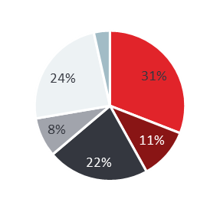
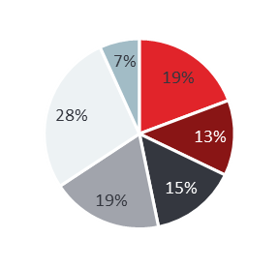
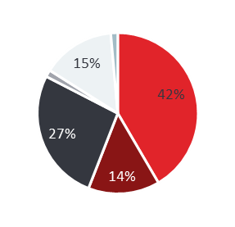
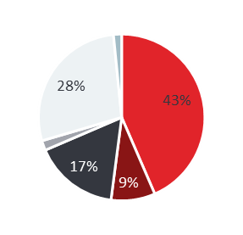

While Super Diagnosers and Key Influencers drive the highest share of top-decile targets, they require fundamentally different engagement strategies due to distinct specialty and profile mix
Super Referrers
Key Influencers
Bridgers
Super Diagnosers
Super Treaters
(n=549)
(n=1271)
(n=280)
(n=717)
(n=315)
Specialty Mix
% of Target List Covered*
2% | 12% | 2% | 9% | 4%
2% | 18% | 3% | 25% | 14%
Holistic Treaters (53%) | Innovators (50%) | Holistic Treaters (40%) | Innovators (45%) | Holistic Treaters (42%) | Innovators (73%) | Innovators (75%)
~3 pts/HCP receiving referrals vs market avg. <2 | ~9 pts/HCP managed vs market avg. ~2 | ~12 pts/HCP managed vs market avg. ~2 | ~16 pts/HCP receiving NT diagnosis vs market avg. ~1 | ~7 pts/HCP receiving NT treatments vs market avg. <1
% of Decile 6-10 Covered*
Primary Attitudinal Segment
Key patient referral insights
* Amongst target list HCPs who are part of Referral Universe : N=7585
Notes:
Total HCPs : 67,197 Targeted Cohort: 5,207 Treaters: 265 Diagnosers: 296 Bridgers: 96 Influencers: 621 Referrers: 3929

Slide 9
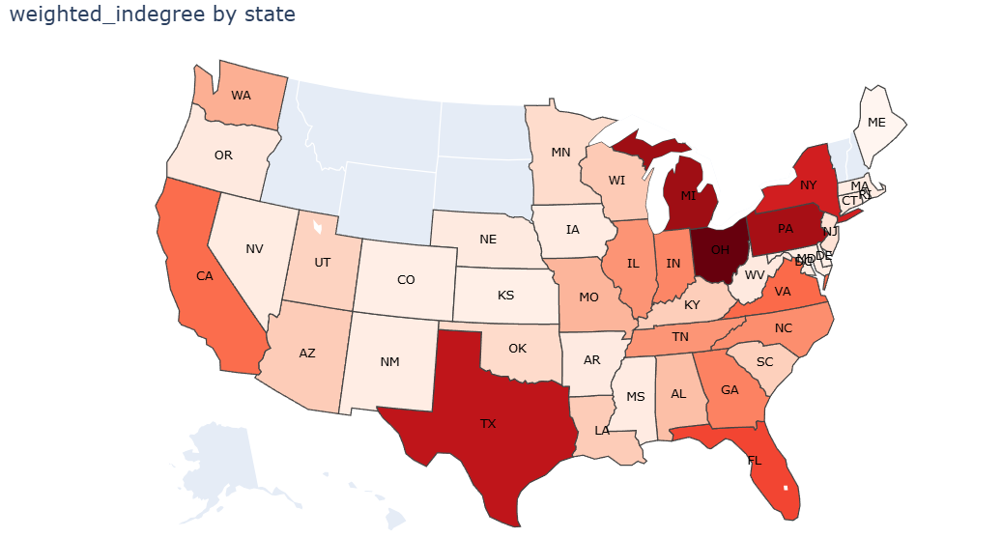
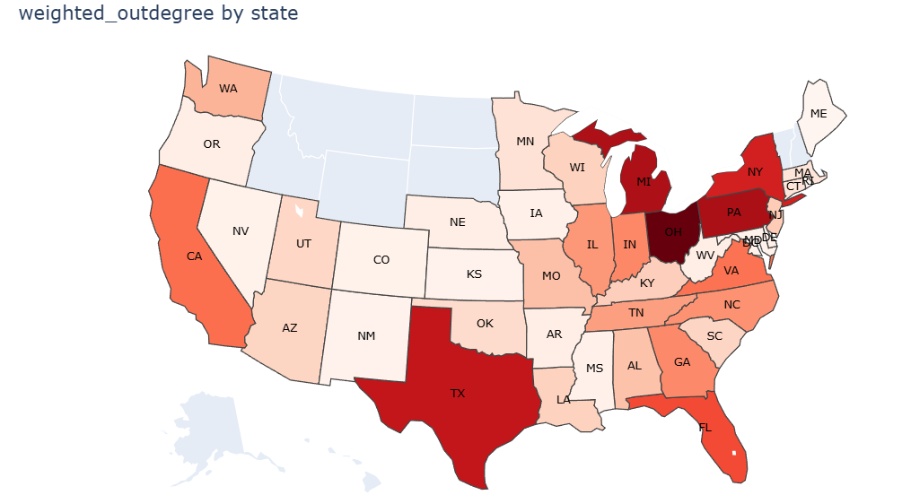
NT referral activity is geographically concentrated in the Southeast and mid-Atlantic, but high volume does not always signal a well-connected network
Key Insights
OH is the single most active referral hub in the country with HCPs referring and rendering activity, followed by MI, PA and NY
The Southeast corridor (VA, TN, GA, NC, SC, FL) shows consistently elevated activity across both metrics indicating regional clusters with more structured referral activities

Slide 10
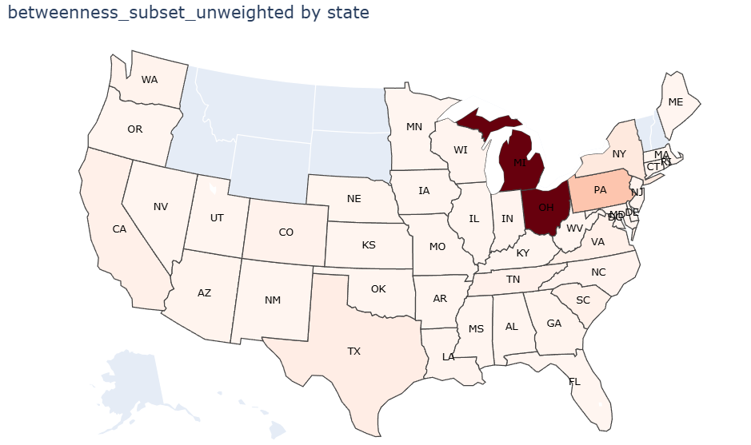
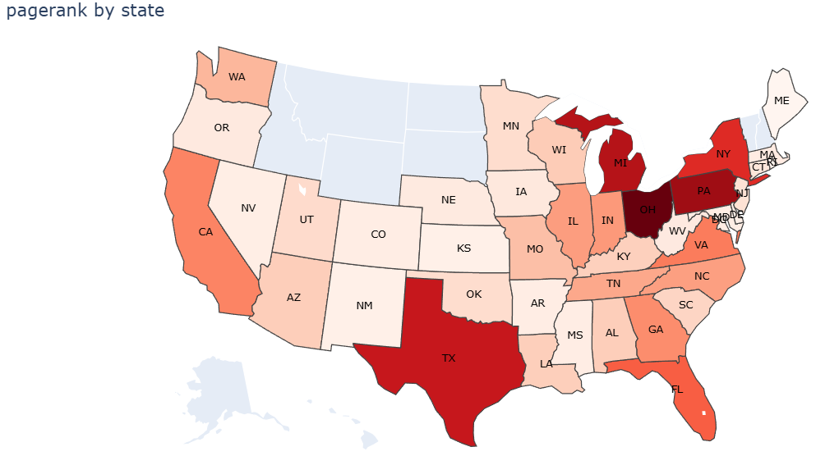
Michigan, Pennsylvania, and Ohio form the structural backbone of the NT referral network, where engagement has the highest systemic leverage beyond raw volume
Key Insights
FL and CA shows strong indegree and outdegree consistent with specialist concentration, but the network influence metrics indicate a lack of establish referral pattern
MI, PA and OH show strongest signal of a mature, trusted referral network with most critical bridges and high-quality inflow making them most structurally complete market in the country

Slide 11
NT referral communities are defined by relationships, not institutions as HCPs consistently refer within their behavioral network regardless of where they practice
Referral activity concentration
Identifying the underlying clusters
6,174
Total HCP Clusters
Communities with 3 or more HCPs exchanging the referrals primarily amongst themselves
548
Self-sustained HCP HUBs
Communities with 1-2 HCPs managing 2+ patients and diagnosing or treating more than 67% of them
4,871
Standalone HCPs cohorts
1-2 connected HCPs with no prominent referral or treatment activity
Key Insights
Patients are not being systematically funneled toward high-expertise centers. Instead, wherever a patient lands, a micro-community of HCPs manages them in isolation
99% of identified HCP clusters contain the majority of their referral activity within the community. Confirming that referral behavior in NT market is governed by established HCP relationships, not institutional proximity or affiliation
With ~5 patients per cluster, individual HCPs never accumulate sufficient NT patient volume to become confident specialists, which could potentially perpetuate misdiagnosis, diagnostic delay, and suboptimal treatment decisions at the community level
Only 26% of the referrals are within the same corporate account, indicating cross-institutional communities participating in referrals
Identifying these communities requires uncovering HCP clusters

Slide 12
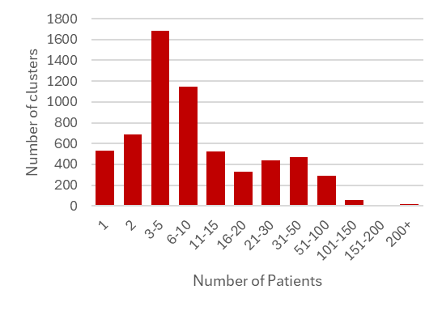
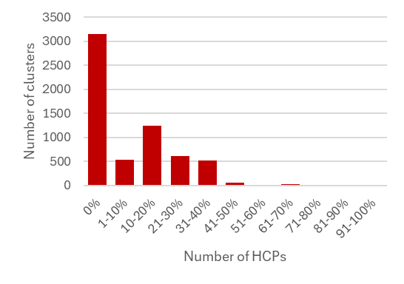
The majority of NT referral clusters are small, PCP-led communities with near-zero overlap with current target lists, indicating that most NT patient management is occurring below the commercial radar
Cluster Profiling
NT Patients Managed Across Clusters
HCP Concentration Across Clusters
Top 10 States Accounting for 50% of Cluster Concentrations
State Code | % of Clusters Covered
TX | 7%
CA | 7%
FL | 6%
OH | 6%
NY | 5%
MI | 4%
PA | 4%
NC | 3%
IN | 3%
TN | 3%
Target List Constitution Within Clusters
Decile 6-10 Constitution Within Clusters
Primary Specialty Across Clusters
Speciality | % of Clusters Covered
Sleep Specialists | 3%
Neurology | 4%
Psychiatrist/ Psychologist | 18%
Pulmonologist | 4%
PCP/NP/PA | 58%
Others | 13%

Slide 13
Misdiagnosis affects at least 70% of NT patients, with Anxiety and Fatigue driving early diagnostic misdirection and Sleep-related conditions serving as the most proximate gateway to NT identification
 |  | Where in the patient Journey are patients getting dropped |  |  |  | Traits associated with these Leakage points
Misdiagnosis | Number of Patients | % of Patients that get this misdiagnosis | Avg Delay per Patient (# days) | Median Delay per Patient (# days) | Total Delay for all Patients (# days) | Avg Days to NT Dx (from the Last Dx) | Median Days to NT Dx (from the Last Dx)
Anxiety Disorder | 23,680 | 70% | 359 | 226 | 8,492,939 | 335.47 | 122
Mood Disorder | 24,554 | 72% | 361 | 225 | 8,857,740 | 318.95 | 117
ADHD | 8,216 | 24% | 346 | 213 | 2,846,010 | 331.42 | 98
Chronic Pulmonary Disease | 4,782 | 14% | 328 | 153 | 1,566,489 | 361.15 | 130
Epilepsy | 2,907 | 9% | 234 | 97 | 679,325 | 409.82 | 179
Sleep Apnea | 18,953 | 56% | 344 | 208 | 6,512,208 | 248.29 | 43
Sleep Disorder | 21,697 | 64% | 171 | 97 | 3,705,528 | 324.17 | 89
IH | 2,155 | 6% | 141 | 62 | 304,070 | 317.81 | 94
Fatigue | 21,613 | 64% | 129 | 72 | 2,784,873 | 477.33 | 286
Key Insights
The typical patient journey starts with non-specific psychological and fatigue-related conditions (Fatigue, Anxiety and Mood Disorder), transitions through neurological misclassifications (Epilepsy and ADHD), and eventually converges toward sleep-related diagnoses (Sleep Disorder, Sleep Apnea) just before narcolepsy is identified.
The proximity of a misdiagnosis to NT identification varies significantly by condition: Sleep Apnea and Sleep Disorder consistently appear as the final misdiagnosis before NT is confirmed, making the HCPs managing these patients, even beyond sleep specialists, the most actionable intervention point
Early journey HCPs: Those managing Fatigue, Anxiety, Mood Disorder pose an opportunity for awareness and earlier NT suspicion
Late journey HCPs: Those managing Sleep Apnea and ADHD showcase opportunity on building confirmation confidence for faster NT referrals & Diagnosis

Slide 14
Markov Chain Analysis Reveals Systemic Pre-Diagnosis Referral Leakage through Specialty and Persona
* Treaters and Diagnosers are part of the targets, thus they have a 0-misreferring score
Misreferring Score | NP/PA | Neurology | Other Non-Specialists | Other Specialists | PCP | Psychiatrist | Psychologist | Pulmonologist | Sleep Specialists
0 | 47.70% | 51.00% | 46.30% | 48.70% | 52.30% | 42.90% | 46.50% | 41.60% | 55.70%
0.0–0.2 | 2.70% | 3.10% | 2.50% | 2.80% | 2.70% | 3.30% | 3.50% | 2.90% | 3.10%
0.2–0.4 | 6.60% | 6.90% | 7.20% | 6.70% | 6.50% | 8.10% | 7.20% | 8.60% | 7.80%
0.4–0.6 | 12.60% | 10.30% | 14.60% | 10.50% | 11.90% | 13.60% | 11.60% | 13.50% | 8.50%
0.6–0.8 | 8.30% | 6.90% | 8.80% | 6.50% | 7.70% | 8.10% | 6.20% | 8.90% | 5.70%
0.8–1.0 | 4.90% | 3.70% | 4.70% | 2.80% | 3.70% | 3.60% | 3.20% | 4.70% | 3.00%
1 | 17.10% | 18.00% | 15.80% | 22.20% | 15.30% | 20.40% | 21.90% | 19.80% | 16.20%
# of HCPS | 6724 | 2274 | 4786 | 5033 | 23499 | 3950 | 4051 | 2303 | 1407
BRIDGER | DIAGNOSER | INFLUENCER | REFERRER | TREATER | All Other HCPs in Referral Universe
25.00% | 100.00% | 36.20% | 19.20% | 100.00% | 49.10%
15.40% | 0.00% | 4.90% | 10.10% | 0.00% | 2.70%
27.50% | 0.00% | 12.70% | 21.90% | 0.00% | 6.60%
21.80% | 0.00% | 17.00% | 23.10% | 0.00% | 12.00%
9.60% | 0.00% | 12.80% | 16.50% | 0.00% | 7.60%
0.70% | 0.00% | 6.20% | 5.50% | 0.00% | 3.80%
0.00% | 0.00% | 10.20% | 3.60% | 0.00% | 18.10%
280 | 717 | 1271 | 549 | 315 | 65039
Key Insights
~56% of Sleep Specialists reliably reach Treaters/Diagnosers through referrals acting as the most effective entry points into the correct care pathways, whereas Psychologists, Psychiatrists, and Pulmonologists lag with ~40% of HCPs reaching target nodes
15–22% of HCPs across most specialties fail to reroute their patients eventually for diagnosis and referrals. This consistent distribution across specialties suggest a systematic issue in the Narcolepsy Market beyond generalists
The identified Bridgers consistently maintain at least some referral relationship which helps redirect patients to targeted HCPs

Slide 15
Misdiagnosis and referral gaps in key specialties are driving the longest delays” “Psychiatry, PCPs, and NP/PAs emerge as major Sink Nodes in the journey
Specialty | Avg. delay (#days) | Primary Point of Delay (Overall) | Primary Point of Delay (Misdiagnosis) | Referrals Made to Sink Nodes
Sleep Specialists | 59.06 | Chronic Pulmonary Disease | IH | 246
Neurology | 71.70 | ADHD | Epilepsy | 435
Psychiatrist | 149.55 | ADHD | ADHD | 517
Psychologist | 206.79 | IH | Mood Disorder | 559
Pulmonologist | 61.43 | Chronic Pulmonary Disease | Chronic Pulmonary Disease | 646
PCP | 83.06 | ADHD | ADHD | 6452
NP/PA | 90.31 | ADHD | ADHD | 1555
Other Specialists | 55.65 | IH | Sleep Disorder | 880
Other Non-Specialists | 51.28 | Sleep Disorder | Sleep Disorder | 1109
Specialty | # of Sink Nodes
PCP | 638
NP/PA | 417
Other Non-Specialist | 67
Other Specialist | 1218
Pulmonologist | 569
Psychologist | 486
Psychiatrist | 934
Neurology | 479
Sleep Specialist | 321
Referral
Key Insights
Post-diagnosis HCP gap: Of 28,864 HCPs interacting post-diagnosis, only 5,052 actively refer, and 19,141 neither refer nor provide relevant narcolepsy treatment, highlighting major post NT diagnosis care gap
Treatment leakage post-diagnosis: 3,454 patients receive no NT-specific treatment; most (3,333) remain in managed care, and 2,152 receive no further referrals—pointing to ineffective post-diagnosis management
*Sink Nodes ~ HCPS that only act as a rendering node (no outgoing referrals), have No NT Activity and are interacting with patients >=1 are classified as a sink Nodes

Slide 16
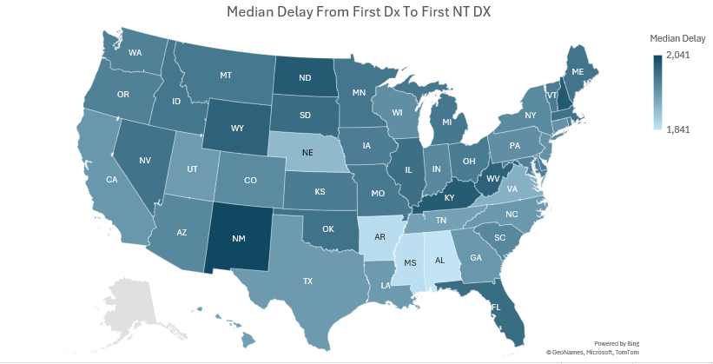
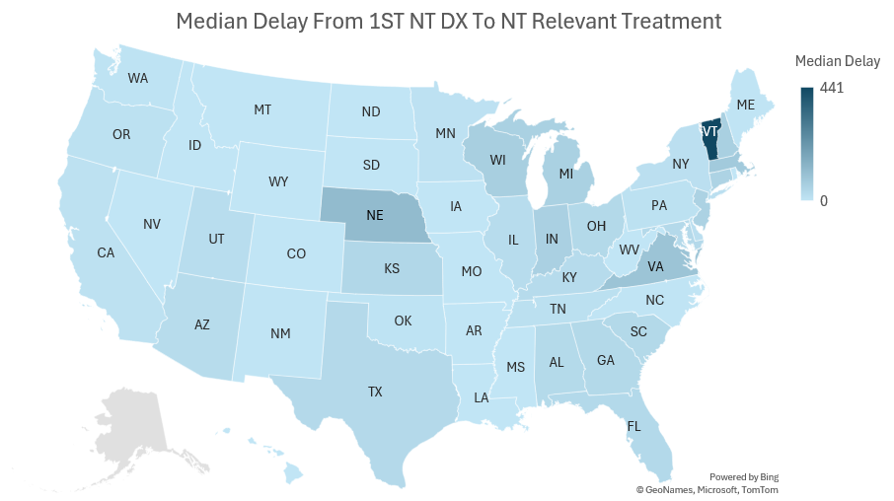
States with the longest diagnostic gaps are not the same where treatment access is slowest, pointing to distinct regional intervention priorities
Key Insights
Pre-diagnosis inefficiency: Only 2,572 patients reach the diagnosing HCP without reaching a sink point in their journey, while 30,086 patients average 4.01 loops, indicating significant referral bottlenecks.
Post-diagnosis treatment drop-off: Out of 17.1K total treated patients, 9.4K received treatment pre-diagnosis, but 3.5K (~37%) discontinue post-diagnosis, indicating a major gap in treatment continuity

Slide 17
Slide Header: To be added
Slide title : Market Positioning: How large and active is this referral network?
Slide Narrative: Of all HCPs touching NT patients, who is actually part of the referral ecosystem, and how active is it?
Universe funnel: # HCPs managing NT patients (298k) -> # involved in referrals (67k)
Patient funnel: # patients managed (46.8k) -> # referred at least once (32k)
Referral volume: Total referrals | Avg referrals/patient (full universe vs referral-active subset) | Avg referrals/HCP (# of patients received through or sent for referral / Total patients managed)
# of HCPs a patient interacts with throughout the journey
Pre vs. post-diagnosis referral split at both patient and HCP level (sets up the diagnosing and. treating persona distinction in Section 2)
O/p: multi-specialty touchpoints, misdiagnosis. NT patients face a long, fragmented path to diagnosis and treatment

Slide 18
Section 2 — HCP & HCO Roles: What function does each node serve in this network?
Framing question: Within the referral ecosystem, what distinct roles do HCPs and institutions play and who is connecting patients to the targeted parts of the network?
HCP Personas
Persona definitions (e.g., diagnoser, treater, referrers, bridgers, influencers)
Specialty, tier, and regional distribution per persona
Pre vs. post-diagnosis involvement by persona (connecting the story to Section 1 split)
HCO Personas
Institution-level role definitions
Specialty, tier, and regional distribution
Bridger Profiles (can be a callout/highlight slide as they have mentioned bridgers in different context in their RFP’s KBQ)
HCPs and HCOs acting as bridgers between otherwise disconnected clusters
Profile: specialty, region, patient management volume, HCP referral directionality

Slide 19
Section 3 — Referral Concentration: Where do referral flows cluster geographically and structurally?
Framing question: Which clusters dominate the referral network and where is referral activity self-contained vs. externally dependent?
Cluster Distribution
HCP-level, HCO-level, and regional cluster distribution
Cluster Profiles (top clusters by function)
Top treating clusters | Top diagnosing clusters | Top refer-out clusters
Per cluster: specialty mix, regional mix, pre/post-diagnosis involvement, misdiagnosed/diagnosed/treated patient counts, internal vs. external referral ratio
Institutional Concentration
% of referrals occurring within same HCO / corp parent (moved from Section 2) ->
Implication: how much of the network is self-referral vs. cross-institutional
Self-Sustained Hubs (highlight callout in the previous slide itself)
Single/double-HCP clusters with high treatment or diagnosis volume
Name, region, specialty, and treatment profile

Slide 20
Section 4 — Patient Leakage: Where are patients falling out of the care pathway?
Framing question: At which points in the referral journey are patients failing to reach diagnosis or treatment and which network characteristics indicate leakage?
[Metrics still being assessed; placeholder framework below for when data is ready]
Patient Journey assessment
Drop-off by referral step: % of referred patients who complete each handoff vs. drop out [patients who had to reinitiate their own journey]
Time-gap analysis: Referral-to-diagnosis lag; diagnosis-to-treatment lag [by cluster and region]
Unresolved referral volume: Patients referred but never reaching a treating HCP
HCP/HCO Assessment
Cycling patients: Patients with ≥N referrals + NT diagnosis and no treatment initiation [likely diagnostic bottleneck]
Geographic access gaps: Regions with high patient volume but low specialist density or cluster coverage

Slide 21
NT referral activity is geographically concentrated in the Southeast and mid-Atlantic, but high volume does not always signal a well-connected network
Key Insights
TN is the single most active referral hub in the country with HCPs referring and rendering actively
The Southeast corridor (TN, GA, NC, SC, AL) shows consistently elevated activity across both metrics indicating regional clusters with more structured referral activities

Slide 22
Michigan, Pennsylvania, and Ohio form the structural backbone of the NT referral network, where engagement has the highest systemic leverage beyond raw volume
Key Insights
TX shows strong indegree and outdegree consistent with specialist concentration, but the network influence metrics indicate a lack of establish referral pattern
MI, PA and OH show strongest signal of a mature, trusted referral network with most critical bridges and high-quality inflow making them most structurally complete market in the country
MS appears prominently on PageRank despite being modest on volume metrics showing signs of a sleeper market with unexpectedly influential HCPs

